Slide 1

DSAI4205 Big Data Analytics
Assignment 2 ROGUE Scores

Slide 2
ROUGE (Recall-Oriented Understudy for Gisting Evaluation) Score
Commonly used for text summarization tasks
ROUGE was designed to evaluate the quality of machine-generated summaries by comparing them to reference summaries provided by humans
ROUGE score ranges from 0 to 1
Higher values indicating better summary quality
ROUGE scores are branched into ROUGE-N,ROUGE-L, and ROUGE-S.

Slide 3
ROUGE (Recall-Oriented Understudy for Gisting Evaluation) Score
ROUGE-N: measures the overlap of n-grams (contiguous sequences of n words) between the candidate text and the reference text.
It computes the precision, recall, and F1-score based on the n-gram overlap.
For example:
ROUGE-1 (unigram) measures the overlap of single words,
ROUGE-2 (bigram) measures the overlap of two-word sequences, and so on.
ROUGE-N is often used to evaluate the grammatical correctness and fluency of generated text.

Slide 4
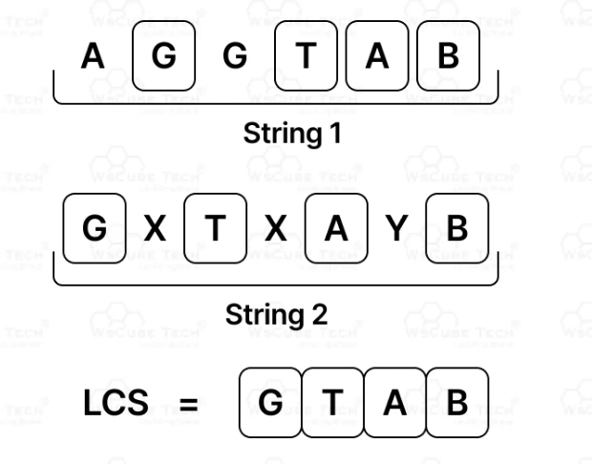
ROUGE (Recall-Oriented Understudy for Gisting Evaluation) Score
ROUGE-L:
Measures the longest common subsequence (LCS) between the candidate text and the reference text.
It computes the precision, recall, and F1-score based on the length of the LCS.
ROUGE-L is often used to evaluate the semantic similarity and content coverage of generated text, as it considers the common subsequence regardless of word order.

Slide 5
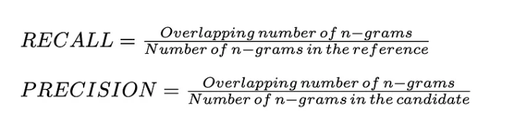
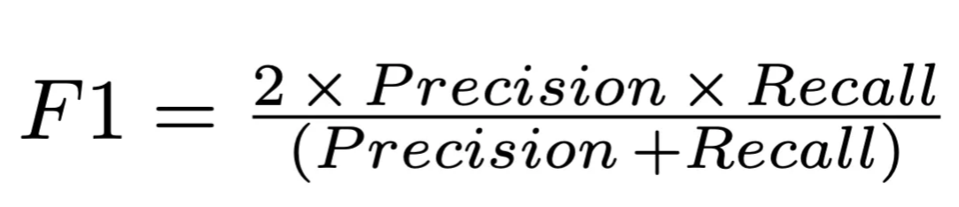
ROUGE-N (N=1)
Candidate 1 (model output): Summarization is cool Reference 1 (true answer): Summarization is beneficial and cool Reference 2 (true answer): Summarization saves time
If we split the word based on 1gram, we get:
 | Candidate 1 1gram | Ref 1 1gram | Ref 2 1gram
1 | Summarization | Summarization | Summarization
2 | is | Is | saves
3 | cool | beneficial | time
4 |  | and
5 |  | cool
6
7
8
9
Count | 3 | 5 | 3
ROUGE₁-F1 (Candidate1 and the best Reference):
Candidate1 and Reference 1:
Recall = 3/5 = 0.6 Precision = 3/3 = 1 F1-Score = 2 * (0.6) * (1)/(0.6 + 1) = 0.75
Candidate 1 and Reference 2: 0.3
So we take Candiate1 and Reference1 for ROUGE₁(Cand1, Ref1)
If we have more than one candidates and reference, we repeat the above calculation and take average on all the ROUGE₁
Notes:
Ref: https://medium.com/@eren9677/text-summarization-387836c9e178

Slide 6
ROUGE-N (N=2)
Candidate 1 (model output): Summarization is cool Reference 1 (true answer): Summarization is beneficial and cool Reference 2 (true answer): Summarization saves time
If we split the word based on bi-gram, we get:
 | Candidate 1 bi-gram | Ref 1 bi-gram | Ref 2 bi-gram
1 | Summarization is | Summarization is | Summarization saves
2 | Is cool | Is beneficial | saves time
3 |  | beneficial and
4 |  | and cool
5
6
7
8
9
Count | 2 | 4 | 2
ROUGE₂-F1 (Candidate1 and the best Reference):
Candidate1 and Reference 1:
Recall = 1/2 = 0.5 Precision = 1/4 = 0.25 F1-Score = 2 * (0.5 * 0.25)/(0.5 + 0.25) = 0.33
Candidate 1 and Reference 2: 0
So we take Candiate1 and Reference1 for ROUGE₂(Cand1, Ref1)
If we have more than one candidates and reference, we repeat the above calculation and take average on all the ROUGE₂
Notes:
Ref: https://medium.com/@eren9677/text-summarization-387836c9e178

Slide 7
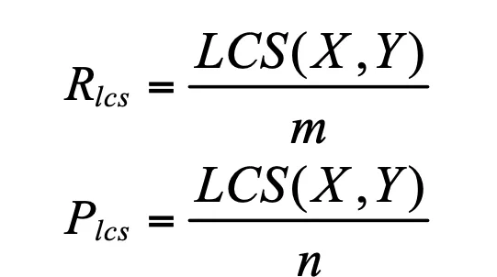
ROUGE-L
Candidate (Model output): Summarization is cool
Reference (True Answer): Summarization is beneficial and cool
 | Candidate 1 1gram | Ref 1 1gram
1 | Summarization | Summarization
2 | is | Is
3 | cool | beneficial
4 |  | and
5 |  | cool
6
7
8
9
Count | 3 | 5
Recall:
Number of words in LCS / Number of words in the reference summary = 3 /5 = 0.6
Precision:
Number of words in LCS / Number of words in the model output = 3 / 3 = 1
ROUGE_{L} F1-score = (2 * 0.6 * 1) / (1 + 0.6) ≈ 0.75

Slide 8

Any Questions?

